Slide 1

WELCOME

Slide 2


Bakery Store Online
Capstone Project Presentation
卒業論文プレゼンテーション

Slide 3
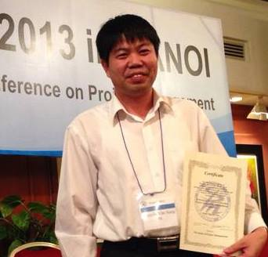
INTRO ABOUT US
Supervisor
指導教員
Nguyen Van Sang

Slide 4





Team Member
チームメンバ
Cao Anh Tuan
Nguyen Xuan Ha
Ngo Trung Kien
Pham Minh Phuong
Hoang Anh Phuong

Slide 5
Outlines -アウトライン
01
02
03
04
Introduction
Project Management
Software Requirement Specification
Software Design Description
導入
プロジェクト管理
プロジェクト管理
ソフトウェア要求仕様

Slide 6
05
06
07
08
Quality Control
Project Result
Demo
Q & A
品質管理
プロジェクト結果
デモ
質問と回答

Slide 7

1. Introduction
導入

Slide 8
03
3
Proposal
02
2
The Idea
01
1
Current Situation

Slide 9
1.1 Current Situation - 現在状況
1
There are a lot of Bakery Store
2
Sale and Marketing focus on social network instead of website
3
Payment method on website

Slide 10
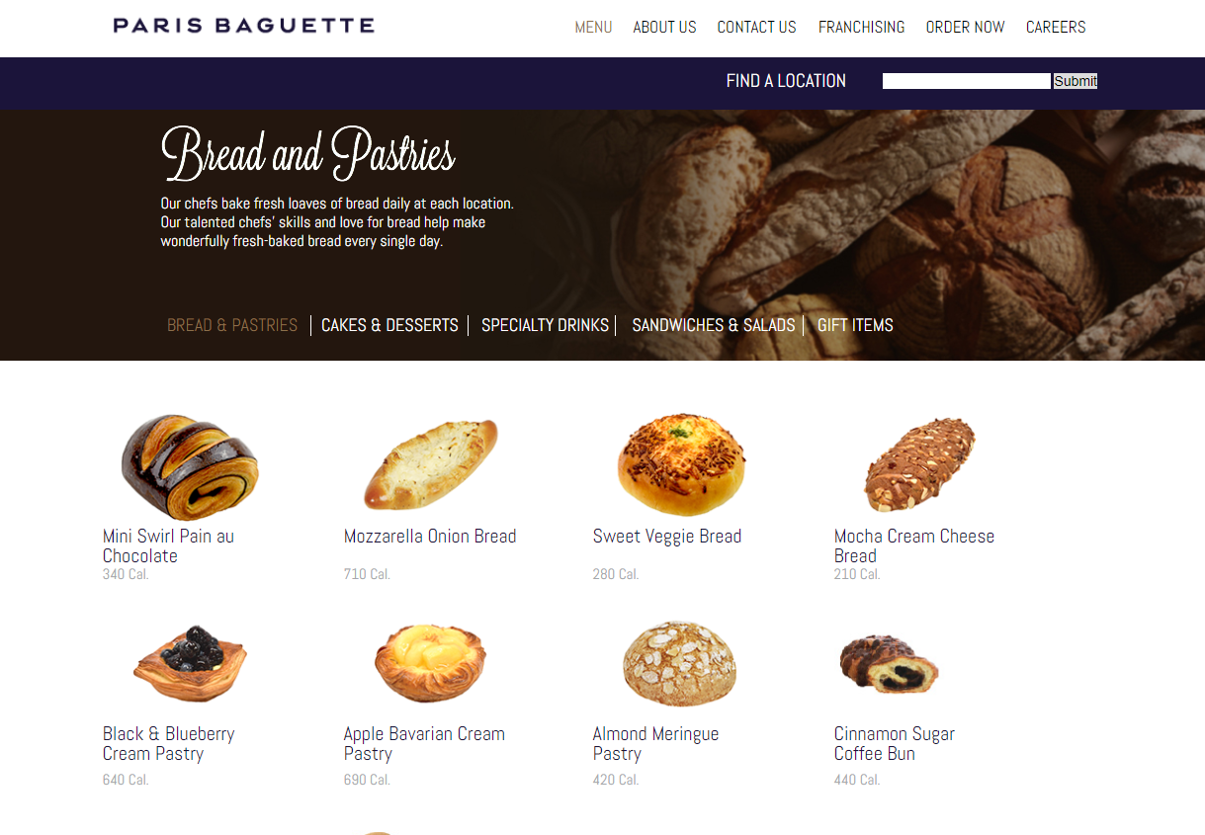

Slide 11
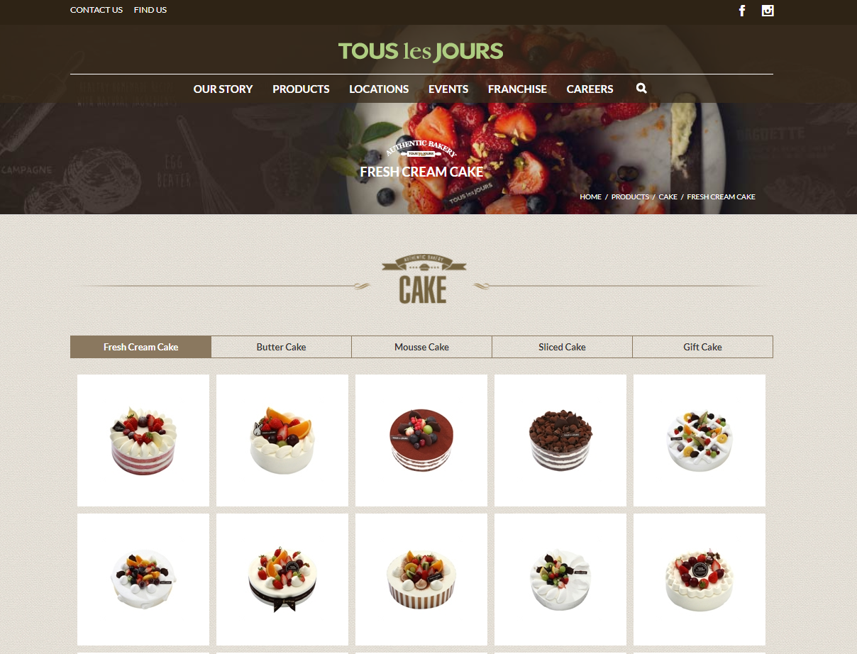

Slide 12
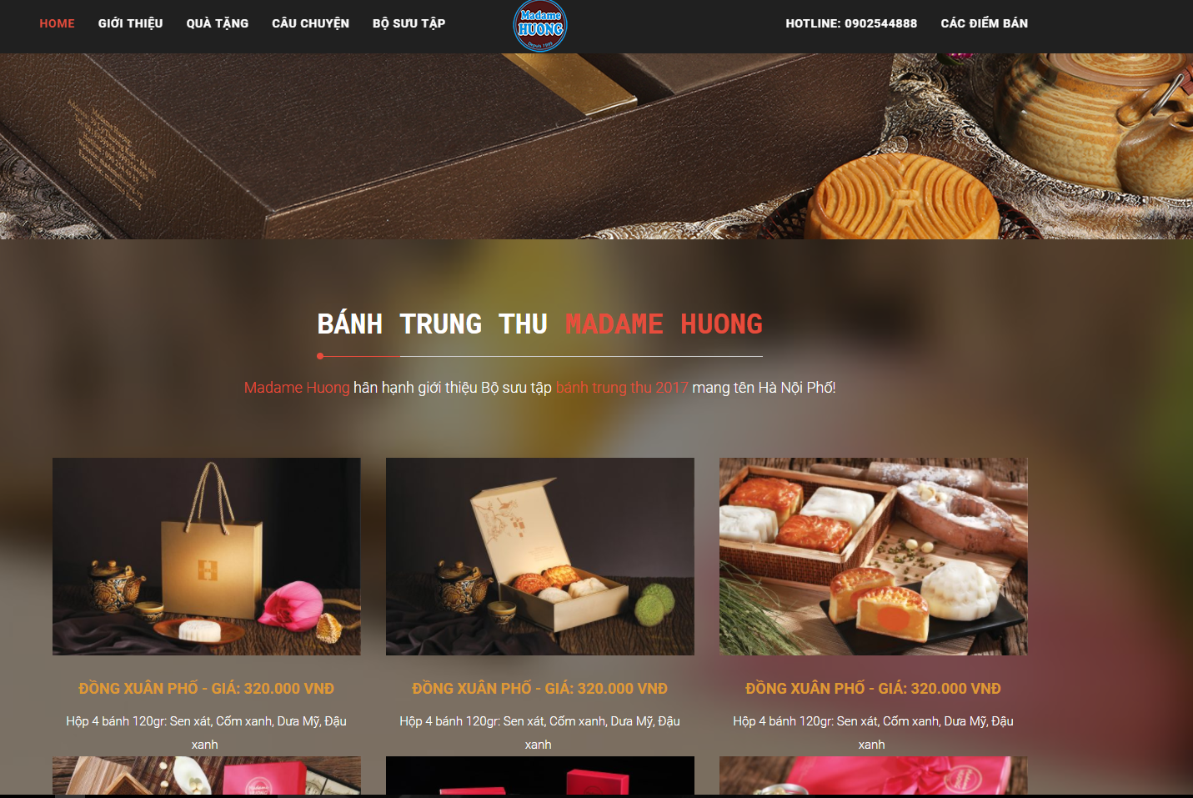

Slide 13
1.2 The Idea - アイデア
Following Promotion Information
Build a website allow
02
03
How to make a cake
01
Buy Cakes

Slide 14
1.3 Proposal - 提案
Uses familiar technologies as: Bootstraps, MVC5, NodeJS…
1
Build a website
Easy to use
2
Proposal
Development, management, teamwork skill
1
Improve team member
Technical experience
2

Slide 15

2. Project Management
プロジェクト管理

Slide 16
2.1 Software Process Model ソフトウェアプロセスモデル
Initiation | Identify business functions of the system Determine scope, condition, limitation, project risk List main functions Complete Report #1
Solution | Complete SRS, Architecture Design and Database Design Complete Report #2
Construction | Report #3, Report #4 Complete Coding and Testing
Termination | Complete software packages and Report #5, Report #6 Preparing presentation Complete Project
Project Life Cycle

Slide 17
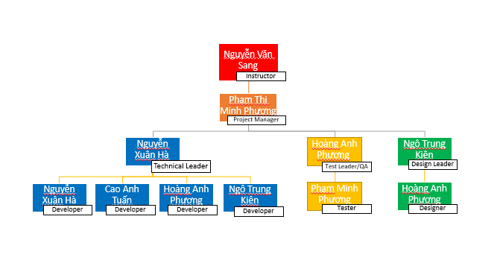
2.2 Project Organization
プロジェクト組織

Slide 18
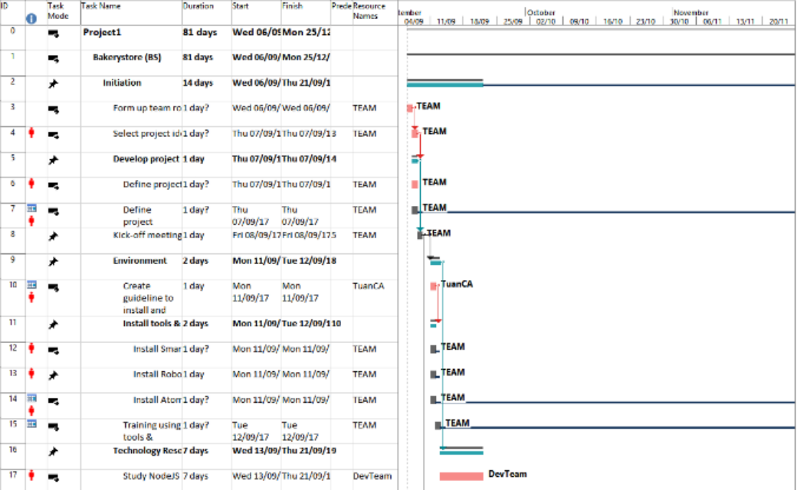
2.3 Project Schedule
プロジェクト計画

Slide 19
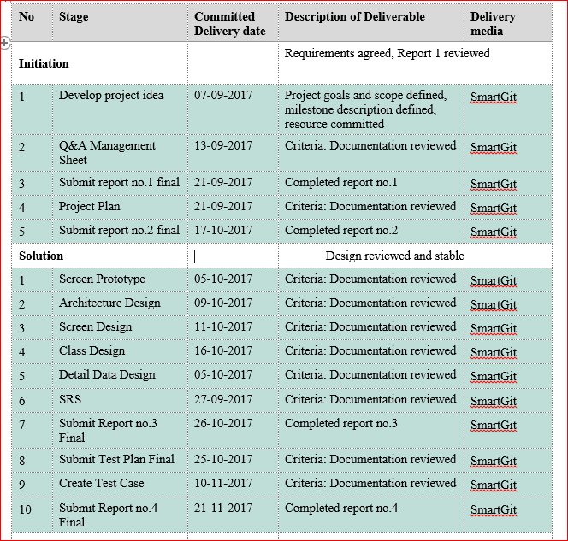
2.4 Objectives & deliverables
目標と成果物

Slide 20










2.5 Tools & Infrastructure ツールと インフラストラクチャ
Tools
Tools for project management
Tools for developing
SmartGit
Word 2013
Excel 2013
Power Point 2013
Astah

Slide 21
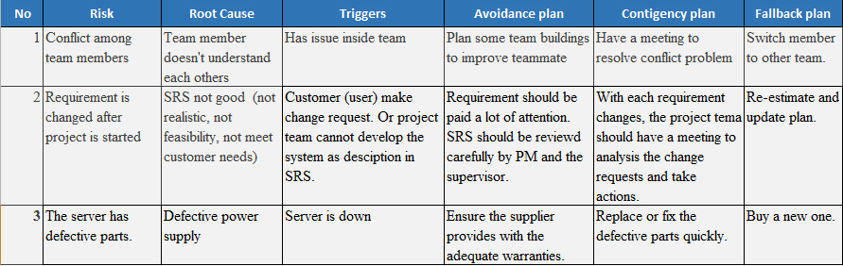
2.6 Risks management
リスク管理

Slide 22
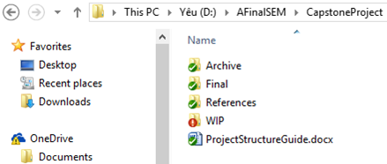
2.7 Configuration management コンフィグレーション管理
Final: Store sent and delivered documents
References: Store reference documents. For example: templates, technologies document…
WIP: Store documents in progress developing
Plan: Plan of capstone project
Users: Working Folder of Member
Documents: Store whole documents in progress developing
Records: Store documents like Meeting Minutes, Q & A Management…
Folder structure of project

Slide 23
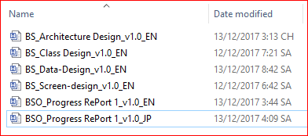
2.7 Configuration management コンフィグレーション管理
Rule: ProjectCode_Document’s name_v<x.x>_language
ProjectCode: FA{
Document’s name: Architecture Design, Class Design…
v<x.x>: document’s version. For example: v1.0, v1.1,…
Language:
EN: English
JP: Japanese
Naming conventions

Slide 24
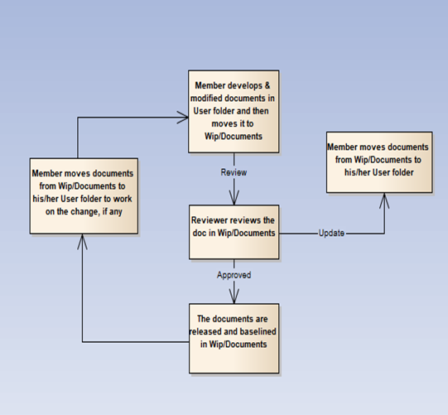
2.7 Configuration management コンフィグレーション管理

Slide 25
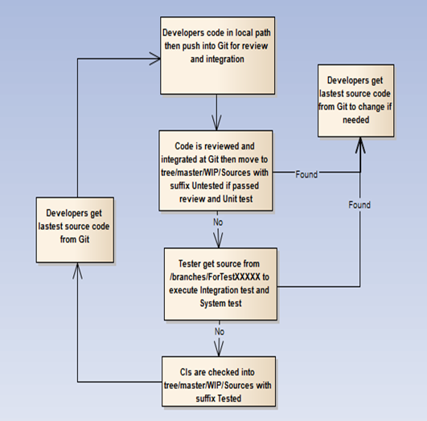
2.7 Configuration management コンフィグレーション管理

Slide 26









2.8 Communication management
コミュニケーション管理
Time: 5 hours/day, 5 days/week.
Location: school, home
Communication
Meeting minutes

Slide 27

3. Software Requirement Specification
プロジェクト管理

Slide 28



3.1 Business Actors -ビジネスアクター
There are 3 actors:
User
Staff
Adminstrator

Slide 29
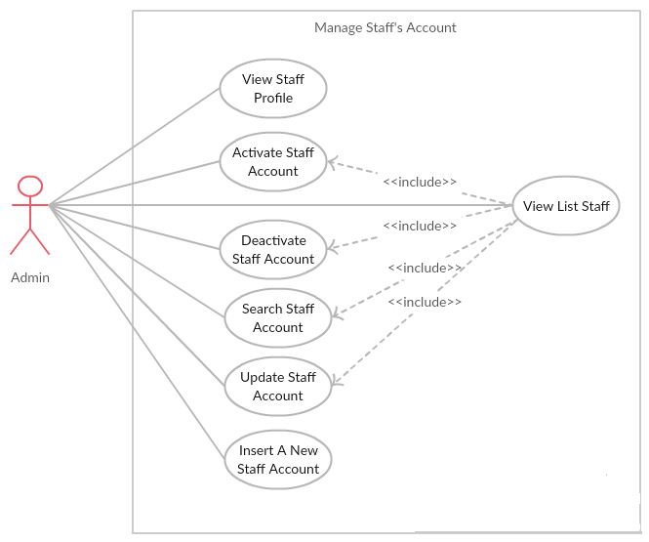
3.2 Functional Requirements - 機能要求
Manage Staff’s Account Module

Slide 30
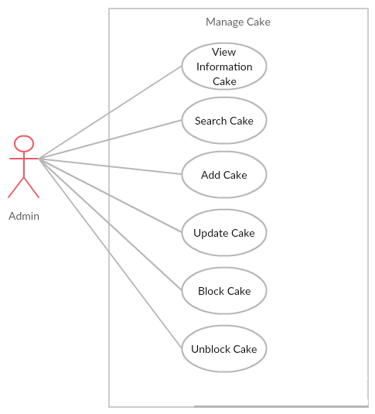
3.2 Functional Requirements - 機能要求
Manage Cake’s Account Module

Slide 31
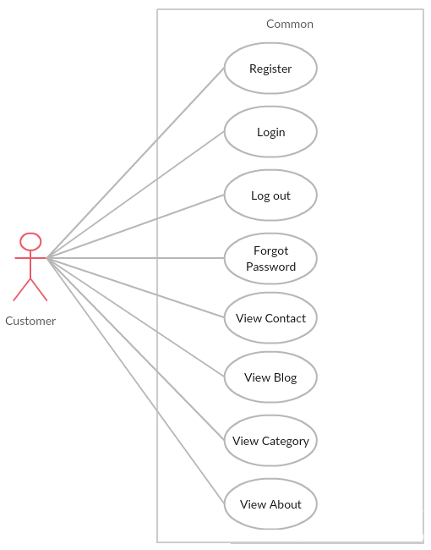
3.2 Functional Requirements - 機能要求
User Module

Slide 32
3.3 Non-functional Requirements - 非機能要求
Availability
The application must be available 95% of time. Users can access to it everywhere from their Web browser with internet connection.
Performance
In term of response time, waiting time of processing will be 8 to 10 seconds; time to process any functions will not exceed 15 seconds.
Maintainability.
Design
The design of the system must be loosely coupled that chances on some module will not affect others.
Usability
- User can complete each function in less than 12 actions
- Output of the project must include coding standards and naming conventions documentations. Implementation code must be easy to maintain

Slide 33
3.3 Non-functional Requirements - 非機能要求
Security Requirements
User authorize
- Each function must be distributed system access and manipulate the individual parts. To edit information, user must declare their username and password before the operation. Functions will be show after users login dependencies user’s role and permission of each user.
Manage Data Layer
- Only Administrator can modify database system

Slide 34




3.3 Non-functional Requirements - 非機能要求
Software Requirements
Chrome
Firefox
Hardware Requirements:
- PC, Laptop , Smartphone with internet connection.

Slide 35

4. Software Design
Description
ソフトウェア要求仕様

Slide 36
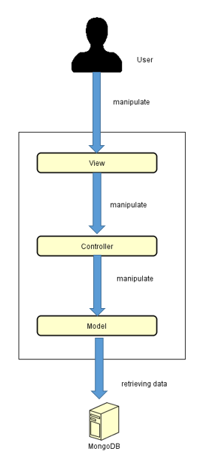
4.1 Architectural Representation –アーキテクチャ表現
Technology:
Nodejs MVC
MongoDB
BS System Overall Architecture
BSシステム全体のアーキテクチャ

Slide 37
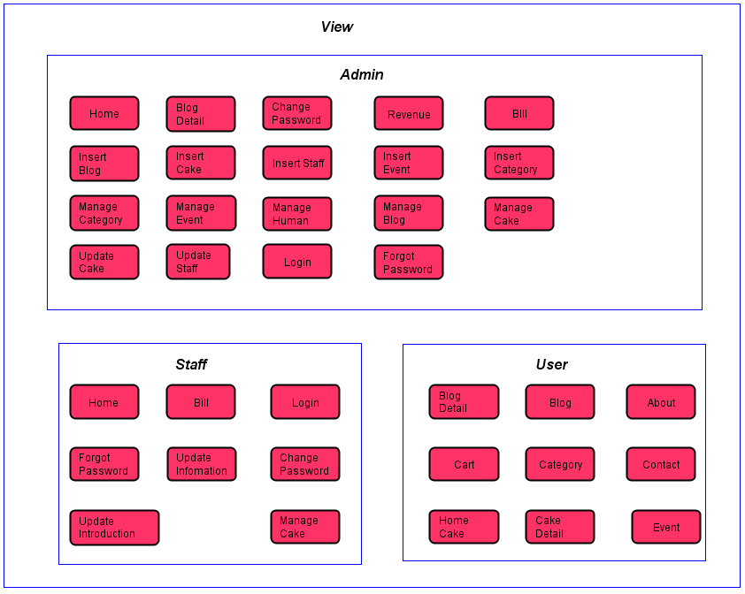
4.2 Package View - パッケージ ビュ
Package View - パッケージ ビュー

Slide 38
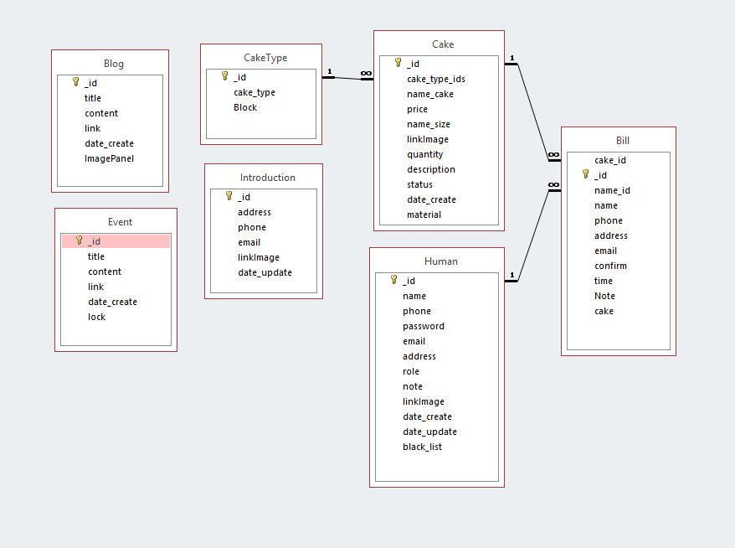
4.3 Database Design -データベース設計

Slide 39
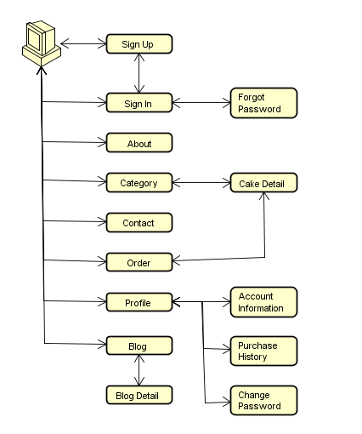
4.4.1 Screen Flow - 画面の流れ
User screen flow

Slide 40
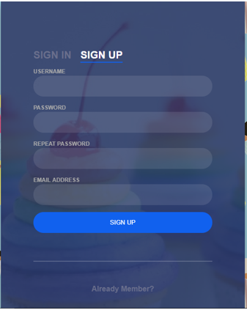
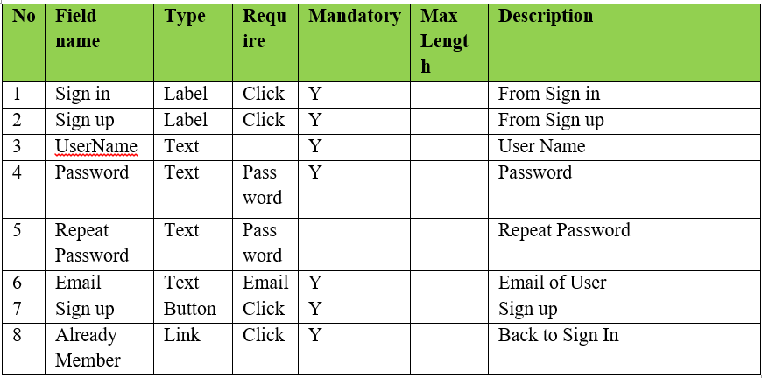
4.4.2 Screen Design - 画面設計
Register screen design

Slide 41
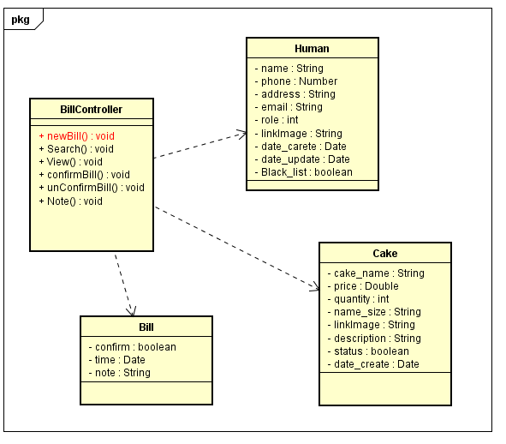
4.5.1 Class Design -クラス設計
CheckOut functions class diagram

Slide 42
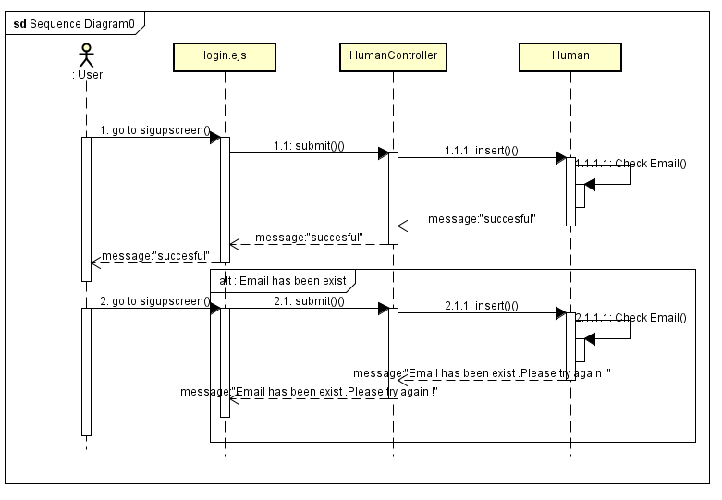
4.5.2 Sequence Diagram -シーケンス図
Register sequence diagram

Slide 43
Quality Control
品質管理

Slide 44
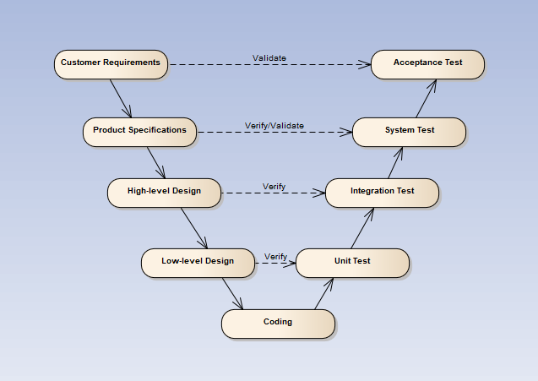
V-model process

Slide 45
5.1 Review
5.1.2 SRS
5.1.3 Design
5.1.4 Code
5.2 Testing
5.2.1Test Process
5.2.2Test Report
5.1.5 Test Document
5.1.1 Project Plan

Slide 46
5.1 Review – レビュー
Self-review
PM review
Peer review

Slide 47
5.2 Test Process
テストのプロセス
Base on Project Plan, Project Schedule , SRS to create test plan:
Features to be tested
Acceptance Test Criteria
Environment
Schedules
Responsibilities
Risks and contingencies
…
1
Create Test Plan
2
7
3
4
5
6
Create Test Case
Review Test Case
Execute Test
Log Bug
Re-test
Create Test Report

Slide 48
5.2 Test Process
テストのプロセス
Acceptance test criteria:
Statement coverage: 100%
Branch coverage: 100%
Path coverage: 100%
Test Approach:
Unit Test: Developer
Integration Test: Tester
System Test: Tester
Acceptance Test: Customer
Test Environment:
Web :Chrome 40 or above
Firefox 30 or above
1
Create Test Plan
2
7
3
4
5
6
Create Test Case
Review Test Case
Execute Test
Log Bug
Re-test
Create Test Report

Slide 49
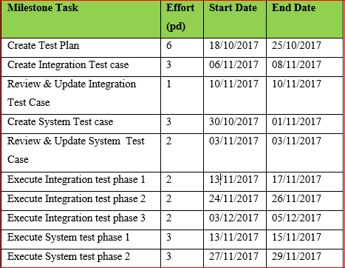
5.2 Test Process
テストのプロセス
1
Create Test Plan
2
7
3
4
5
6
Create Test Case
Review Test Case
Execute Test
Log Bug
Re-test
Create Test Report

Slide 50
5.2 Test Process
テストのプロセス
Base on SRS, create test case:
Integration test case
System test case
Acceptance test case
1
Create Test Plan
2
7
3
4
5
6
Create Test Case
Review Test Case
Execute Test
Log Bug
Re-test
Create Test Report

Slide 51
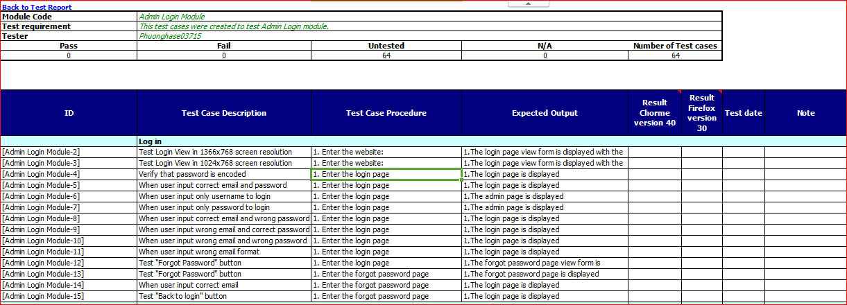
System test case
システムテストケース

Slide 52
5.2 Test Process
テストのプロセス
Tester self-review and peer-review:
Integration test case
System test case
1
Create Test Plan
2
7
3
4
5
6
Create Test Case
Review Test Case
Execute Test
Log Bug
Re-test
Create Test Report

Slide 53
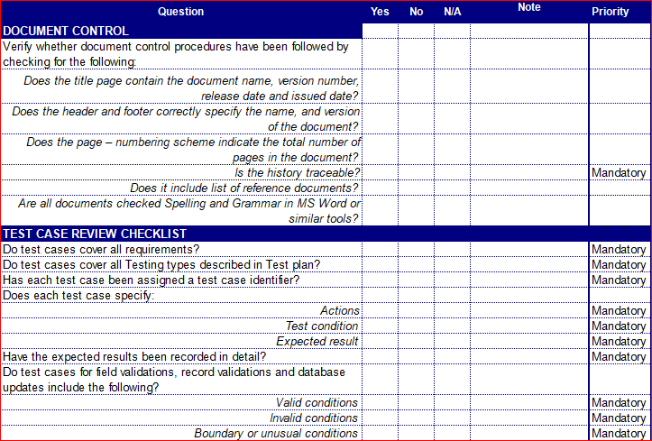
Test case review checklist
テストレビュー

Slide 54
5.2 Test Process
テストのプロセス
Tester execute test case follow phase:
Integration testing
System testing
1
Create Test Plan
2
7
3
4
5
6
Create Test Case
Review Test Case
Execute Test
Log Bug
Re-test
Create Test Report

Slide 55
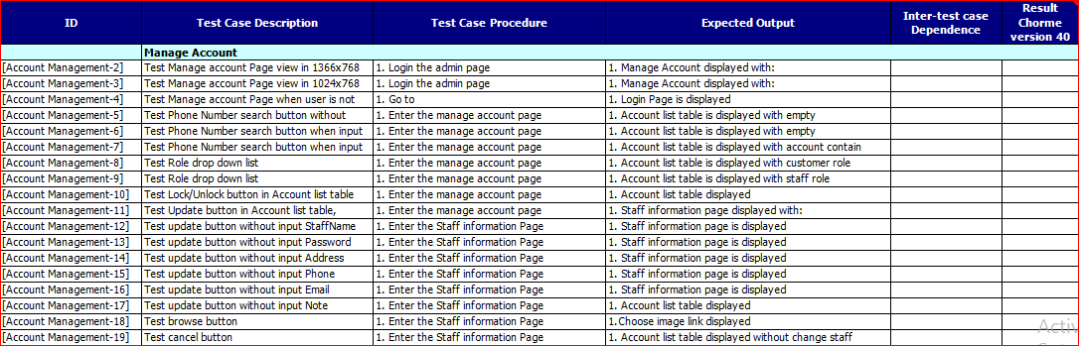
Execute test case
テストケースの実行

Slide 56

Project Result
プロジェクト結果

Slide 57
Project summary – プロジェクト要旨
Main objective | Develop a system which will provide to users functionality to collect funding for their project and back to get the amazing products from creative projects.
Purpose | Provide a bakery store online on website.
Source repository | https://github.com/sangnvus/201709FallJS01
 | Plan | Actual
Start date | 07/09/2017 | 07/09/2017
End date | 25/12/2017 | 13/12/2017
Release versions | 1.0 | 1.0
Duration | 81 days | 70 days
Efforts (person day) | 405 | 350
Test cases | 1000 | 1192
Defects | 100-200 | 66
Document pages | ~ 3000 pages | ~ 3500 pages
Lines of code (nodejs) | ~ 10000 | ~ 15000
Lines of code (HTML) | ~ 5000 | ~ 10000
LOC (Total) | ~ 25000 | ~ 38000

Slide 58
Project summary -プロジェクト要旨
Knowledge:
Work process of FPT Software to develop a project.
Putting the learned knowledge into practice.
Improve skils: teamwork, leader-ship, research and self-study, plan and manage time.
Technical: Heroku, Nodejs, Javascript
Tools: SmartGit, Astah, MS office, Robo 3T, MongoDB, Atom.

Slide 59
Lessons Learnt -学んだ教訓
• The success of a project is largely dependent on the skills and strengths of the people involved. Therefore, a project needs to have a dedicated, talented set of individuals working towards a common goal.
• Always disclose information to those, who will need it. This is not the time or place for obtaining an edge over another by keeping crucial data close to your chest. People, who know what is expected of them and have the means of doing so, will play a pivotal role in making the project a success.
• Know what resources are available. Not just those under your purview but those which are at the discretion of other teams. Sometimes, others may be happy to help.
• Be open to change. Sometimes, you may find that the things you knew along may not be correct at this given time, under these specific conditions.
• Good communication is that which will stop mistakes from becoming failures.
• Please think carefully before making a decision because if the wrong decisions you'll have to redo it from scratch.

Slide 60
Limitation & Expectation -制限と期待
Current Limitations | Expectation in Future
Website not support for Vietnamese language. Not support payment methods for people in other contries. Not support payment by mobile cards and bank card. | Support multi-language and other payment method such as visa and master card to get funding from people in other countries. Support payment by mobile cards such as Viettel, Mobi, Vina, … App for Android and IOS which supports members manage their projects and admin can manage system anywhere by smart phone. Expand server to inscrease number of users.

Slide 61
7. Demo
デモ

Slide 62
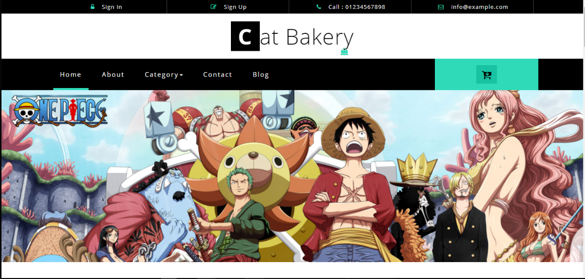
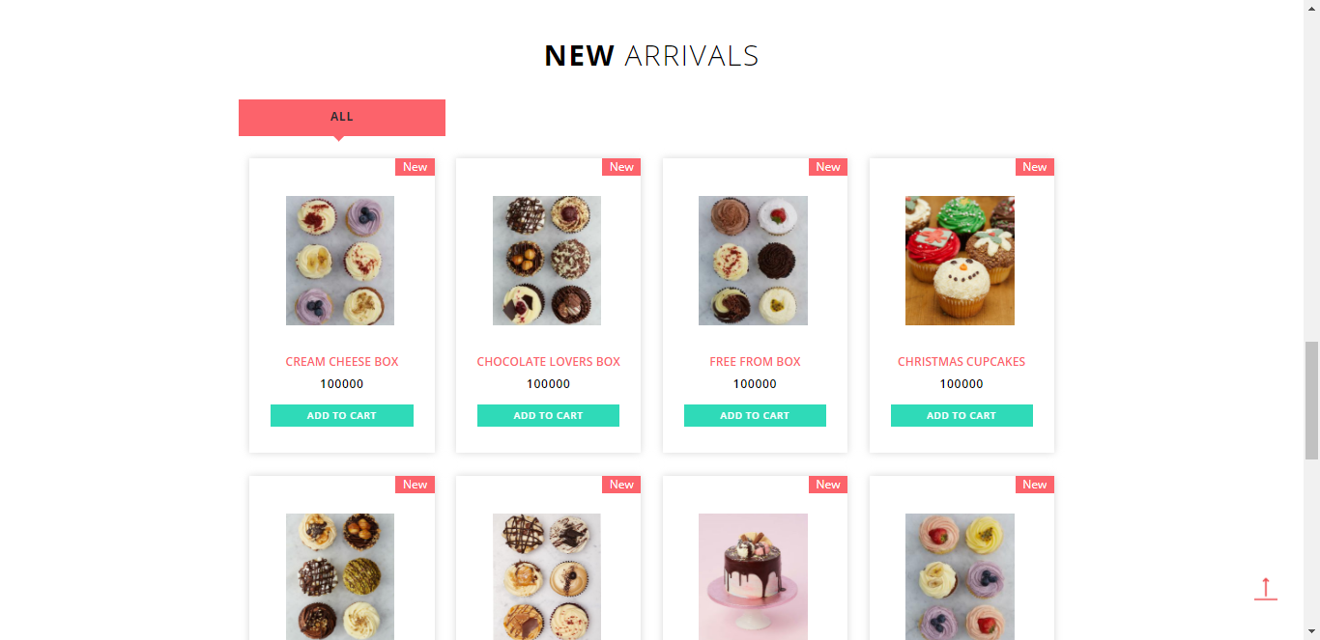
Demo -デモ

Slide 63

Q & A -質問と回答

Slide 64
Q & A SESSION
Q
A
&
THANKS FOR LISTENING
WE’LL BE ANSWERING QUESTIONS NOW

